Slide 1
AN INTRODUCTION TO EMA
(Education Maintenance Allowance)
*All information is based on academic year 25/26 and may be subject to change in future years.

Slide 2
EMA
What Is EMA?
Should I apply ?
How much can I get ?
How can I apply?
What happens next?
References relate to “The little book of EMA for academic year 2025/26

Slide 3
What is EMA?
Education Maintenance Allowance (EMA) is a weekly payment of £40 to help 16-18 year olds with the costs of further education.
Payments are made every 2 weeks as long as you meet your school or college’s attendance criteria.

Slide 4
Should I apply ?
You could get EMA if all the following apply to you:
you live in Wales
you will be aged between 16–18 on 31 August 2025
you meet our nationality and residency rules
you attend an eligible school or college in the UK This must be full time at school or college, for at least 12 hours per week, and studying an eligible course.
your household income is £23,400 or less and you are the only young person studying full-time in your household
or your household income is £25,974 or less and there are other young people in your household who qualify for Child Benefit.

Slide 5
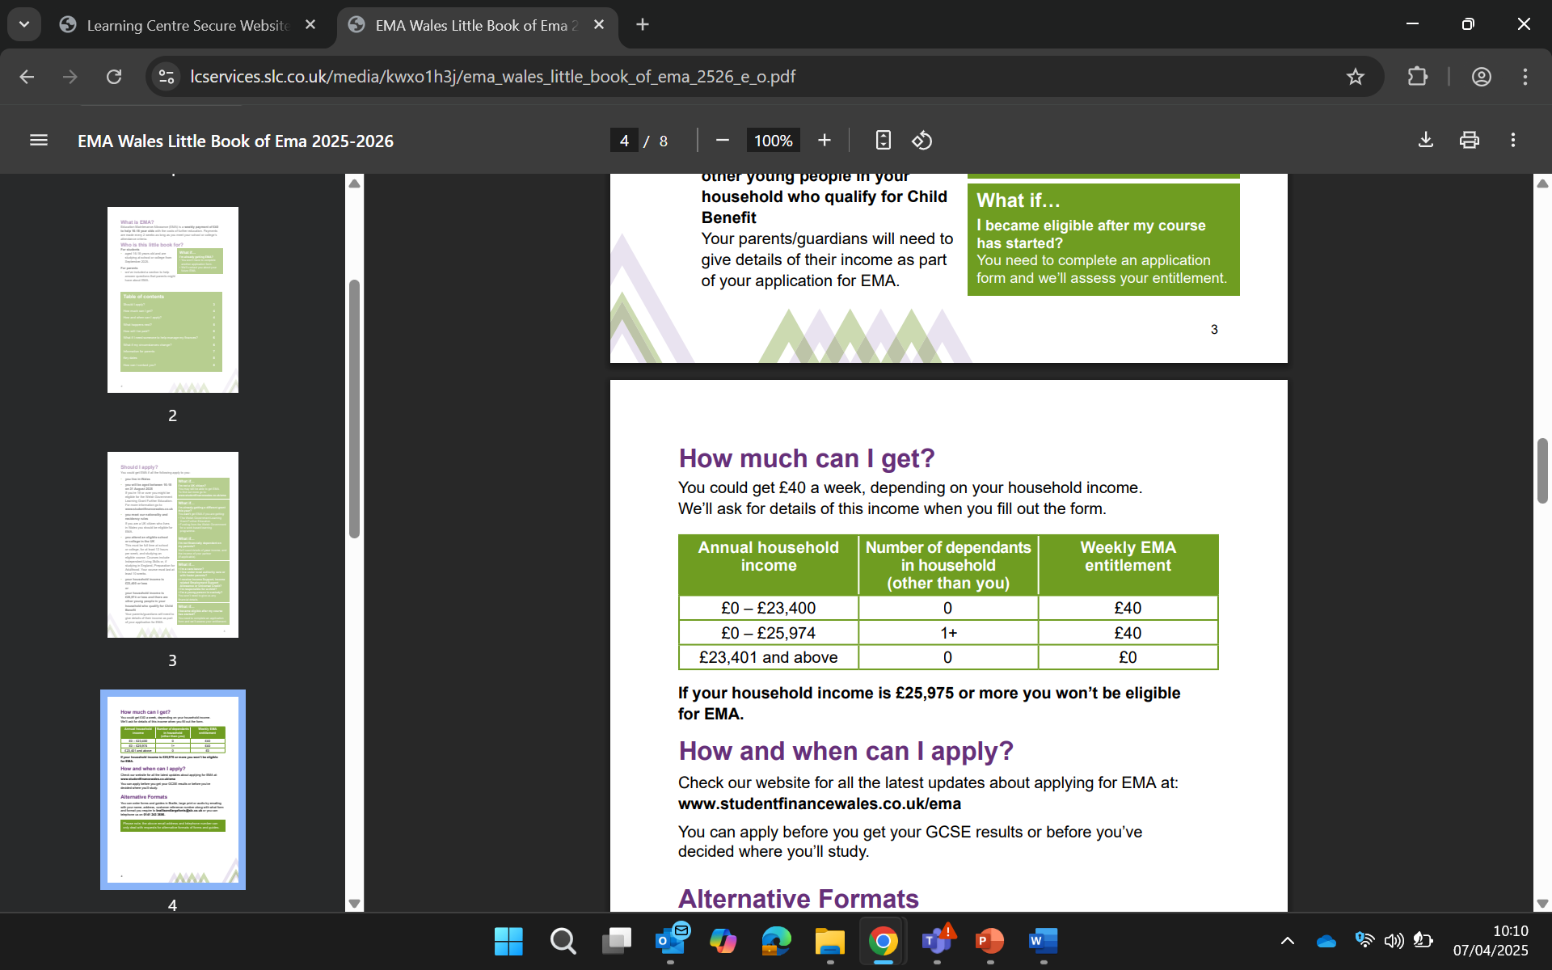
How much can I get?

Slide 6
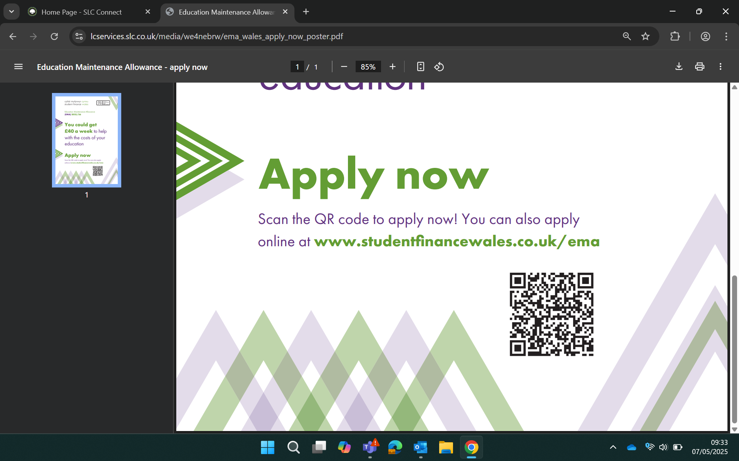
How can I apply?
Check our website for all the latest updates about applying for EMA www.studentfinancewales.co.uk/ema or scan this QR code
You can apply before you get your GCSE results or before you’ve decided where you’ll study.

Slide 7
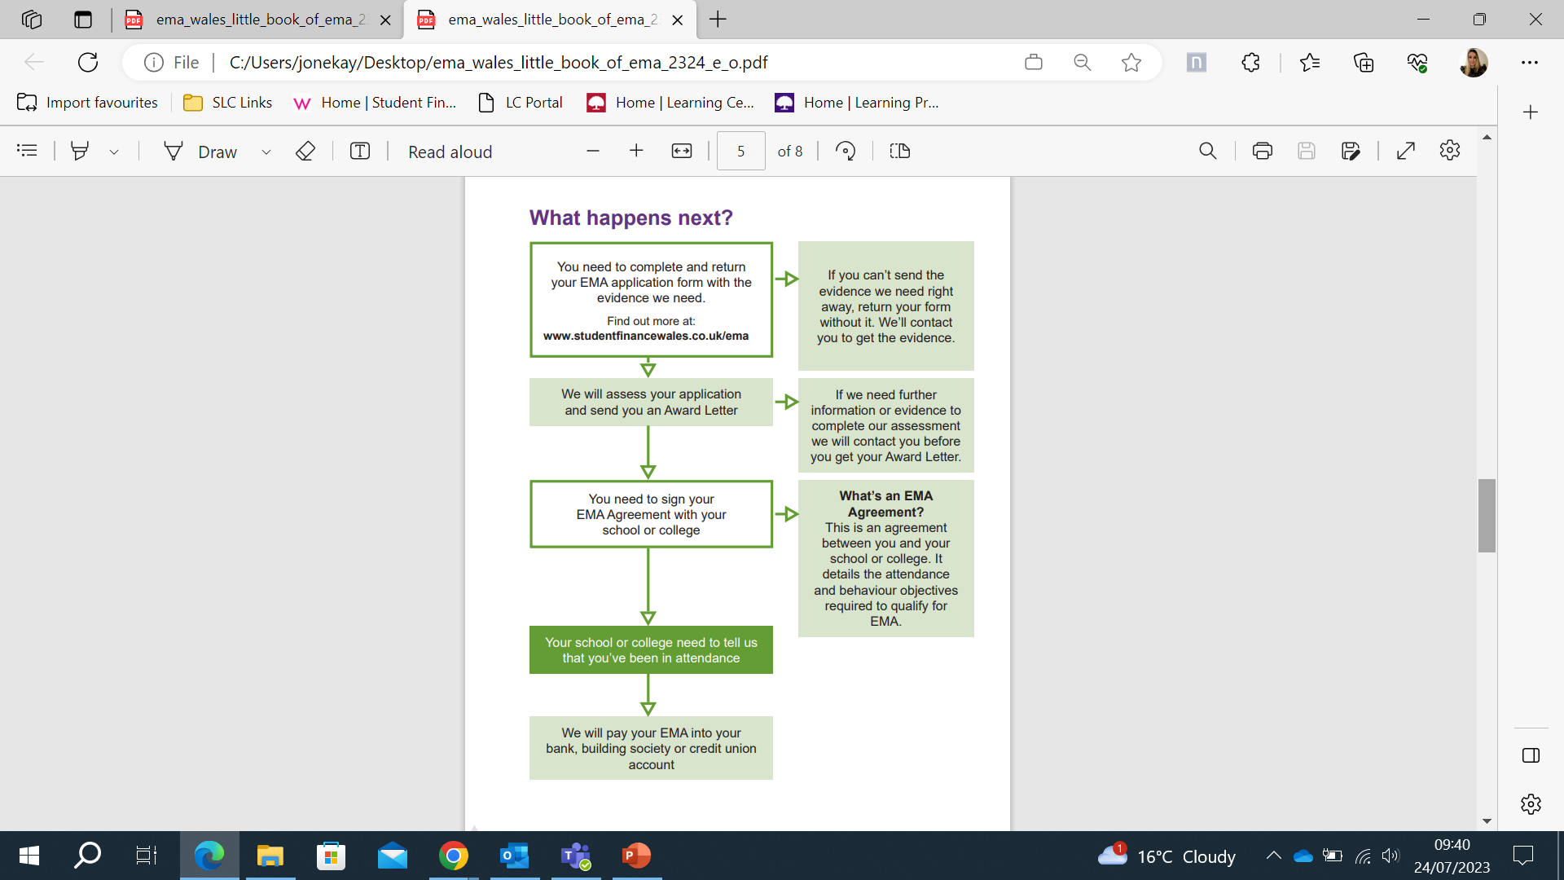
What happens next?

